Slide 2


Slide 3


Slide 4
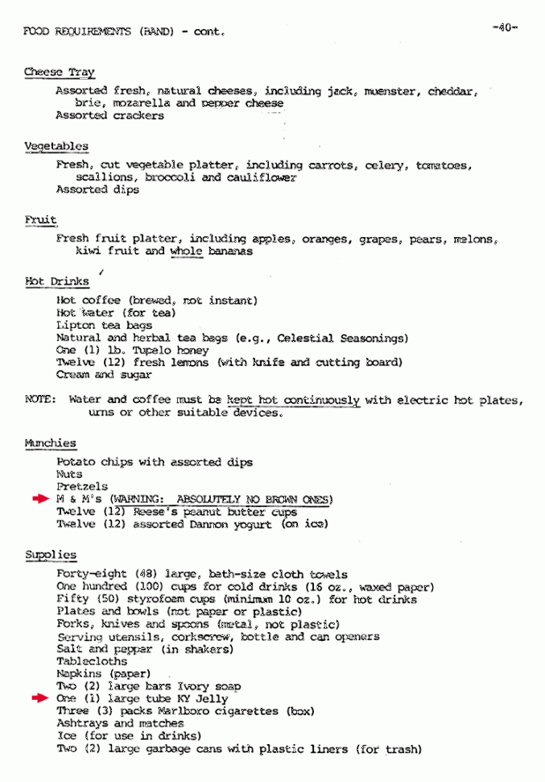

Slide 5
What is a hypothesis?

Slide 6
I hypothesize that:-
All ravens are black.
My phone face has more bacteria than my ID badge.
The drug compound Pioglitazone decreases blood glucose levels in diabetes mellitus type 2 patients.
Smoking is associated with increased risk of cardiac diseases.
An increase in the average temperature in the East coast of the US will lead to increased incidences of Lyme Disease.

Slide 7
A null hypothesis.
A null hypothesis is the name given to a hypothesis that is possibly false or has no effect. Often, during a test, the scientist will study another branch of the idea that may work, which is called an alternative hypothesis.
During a test, the scientist may try to prove or disprove just the null hypothesis or test both the null and the alternative hypothesis.
Example:
Hypothesis: Smoking is associated with increased risk of cardiac diseases.
Null hypothesis:

Slide 8
Statistical Significance
Qualitative Rules?

